Slide 1
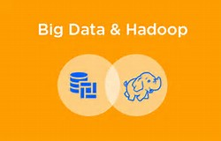
Presented by Ria Sadhu
Batch code –S170026

Slide 2
What is Big data ?
Its not easy to measure the total volume of data stored electronically.
This flood of data coming from many Sources
Facebook hosts more than 240 billion photos , growing at 7 PB per months
The New York Stock Exchange generates 4-5 PB per day
And there are lot of data - 4.4 ZB of data collected in 2003 and forecasting 44 ZB in 2020

Slide 3
Characteristics of big data
4 Vs
Huge volume of data : Rather than thousands or million of rows/records , Big data can be billions of rows and millions of columns
Variety – Data can be any form ,structure
Velocity – Big data can be describe as high velocity data i.e speed of new data creation is rapid ,high data ingestion and near real time analysis
Veracity - The quality of the data being captured can vary greatly. Accuracy of analysis depends on the veracity of the source data

Slide 4
Types of data Structure
Structured: A specific and consistent format
(for example, a data table)
Semi-structured : A self-describing format(for example XML file)
Quasi-structured: A somewhat inconsistent (for example, a hyperlink)
Unstructured : An inconsistent format(for example , text or video)

Slide 5
Main Problem
How to store & analyse such huge data?
Problem :Lots of data of varied form
Need to process 100TB datasets On 1 node: – reading@ 100MB/s = 277.7 hrs= 11 days
Suppose we have 1000 nodes then the same
Data can be read =16.2 minutes only if nodes working in parallel.

Slide 6
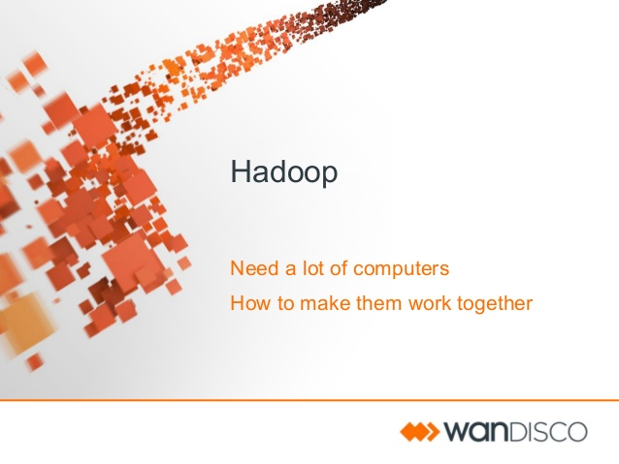

A new way to store and Analyse data

Slide 7
What is Hadoop?
Hadoop ,Also known as Apache Hadoop
Created by Douglas Reed Cutting in 2006
Open source framework used for distributed storage and processing of large data sets on computer cluster built from commodity hardware

Slide 8
Hadoop Cluster
What is cluster?
Normally any set of loosely connected or tightly connected computers that work together as a single system is called Cluster. In simple words, a computer cluster used for Hadoop is called Hadoop Cluster.

Slide 9
Benefits of Hadoop
Scalability
Scale out : Adding more nodes to a cluster
Scale up: Adding more CPU/ram/external hardware to the existing nodes
Reliability – In case of node failure processing is re-directed to the remaining nodes in the cluster and data is automatically re-replicated in preparation for future node failures.
Flexibility – Don’t have to create schemas on write, Schemas created on read
Low cost - Hadoop is open source and runs on low-cost commodity hardware

Slide 10
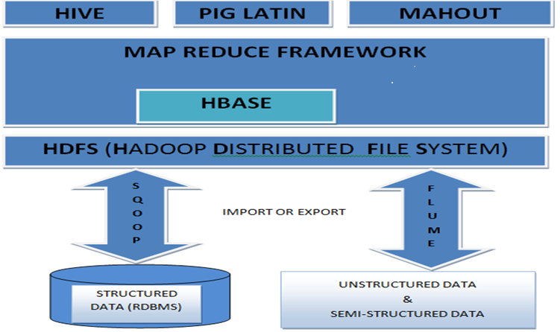
Hadoop Ecosystem

Slide 11
Main components
Consists of two main components: Providing unified cluster view
1. HDFS – a distributed file system • File system API connecting thousands of drives
2. MapReduce – a framework for distributed computations
• Splitting jobs into parts (Map and reduce task)
• Scheduling and monitoring of job execution

Slide 12
HDFS Architecture
Single Namenode which stores the metadata of the filesystem
Multiple Datanodes which do the actual storage work
Nodes are Arranged in racks and replicas of each block are stored in different racks such that in case of rack failure, we can still continue with processing since replicas are present in other racks.

Slide 13
MapReduce framework
This framework includes
User defined <key,value>
User also defines Map Reduce function
Hadoop handles the logistics
Parallel processing is provided
Divides the input into map and reduce task
Communicating intermediate results to Reducers

Slide 14
3 phases in MapReduce
Reducer phase
---------------------------
Input for reducer will be
Grouped (key, values) or the intermediate results
The reduce function will
Iterate the list/values
And produce a final output for each key.
Map phase
------------------------
<input key,input value,output key,output value>
Reads input as <key,value> pairs
And emit output <key,value> pairs
Sort and shuffle
--------------------
Output from all mappers are grouped by key to produce
Intermediate
results

Slide 15
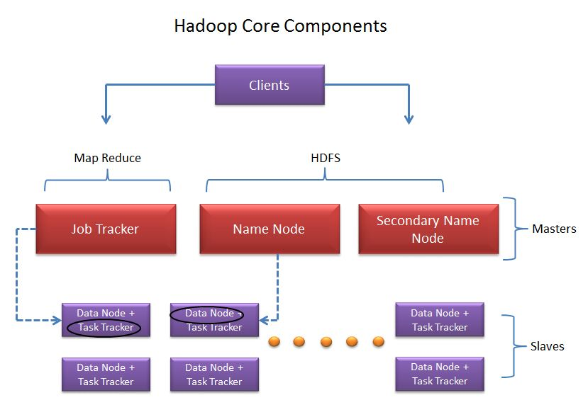
Components of Hadoop Cluster
Client
Master nodes
Slave nodes

Slide 16
Description on HDFS cluster
Client – loads data into the cluster/Submits Map reduce job on how the data should be Processed.
Name Node – Centre piece of hadoop cluster/ Stores the metadata of the filesystem/Runs on dedicated machine.
DataNode – Slave or work nodes/Actual Data is stored on these nodes.
Secondary node – Reduces the work load of Name node by time to time update of edit logs with fs image file periodically.

Slide 17
Description on MapReduce cluster
JobTracker – (Master node) –Replaced by ResourceManager in MRv2/Receives request for Mapreduce execution from clients/Assigns MapReduce tasks to the suitable TaskTracker for execution
TaskTracker – (Slave node)- Replaced by Node manager in MRv2/Deployed in all the datanodes and receives instruction from Jobtracker on how to execute the tasks and sends back Task progress report

Slide 18
MapReduce 1 vs Yarn
Mapreduce 1
JobTracker takes care of job scheduling and task progress monitoring
Slots – in TaskTracker node where Map Reduce task runs
Yarn
The ResourceManager
Schedules the tasks/launches Application masters in NodeManager and ApplicationMaster does task progress monitoring
Containers – in NodeManager node where Application master and Map reduce task runs

Slide 19

Pig
Pig consists of high level scripting/procedural language PigLatin
Used for Extract –Transform-Load(ETL) data sets
Pig enables to solve queries fast without knowing Java
Execution modes
Local mode – read and write data using local system,doesn’t require Hadoop
MapReduce mode – you need access to a Hadoop cluster and HDFS installation

Slide 20

Hive
Hive is SQL based Data warehouse system for data summarization, ad-hoc query, and analysis of large datasets
uses a SQL-like language called HiveQL (HQL).
Hive is not a relational database, but a query engine that supports the parts of SQL specific to querying data
By default hive uses derby database to store metadata.
The location of metastore is metastore_db

Slide 21
Pig vs hive
Procedural Data Flow Language
For Programming
Pig is SQL like but varies to a great extent.
Hive enables developers not familiar with MapReduce to write data queries that are translated into MapReduce jobs in Hadoop.
Declarative SQLish Language
For creating reports
Directly leverages SQL and is easy to learn for database experts.
Its compiler translates Pig Latin into sequences of MapReduce programs

Slide 22
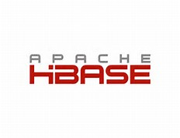
Hbase
Hadoop Database or HBASE is a non-relational (NoSQL) database that runs on top of HDFS.
HBASE was created for large table which have billions of rows and millions of columns with fault tolerance capability and horizontal scalability and based on Google Big Table.

Slide 23

Flume
Data need to process generating from data sources like applications servers, social networking sites, cloud servers, and enterprise servers. This data will be in the form of log files and events.
Apache Flume is a distributed, reliable, and available service for efficiently collecting, aggregating, and moving large amounts of streaming data/logdata into the Hadoop Distributed File System (HDFS).

Slide 24

Sqoop
Sqoop acts like a intermediate layer between Hadoop and relational database systems. You can import data and export data between relational database systems and Hadoop and its eco-systems directly using sqoop.
Sqoop works with relational databases such as Teradata, Netezza, Oracle, MySQL, Postgres, and HSQLDB
Uses JDBC to connect with relational databases

Slide 25
Description of project (H1B – Case Study)
The H1B is an employment-based, non-immigrant visa category for temporary foreign workers in the United States.
For a foreign national to apply for H1B visa, an US employer must offer a job and petition for H1B visa with the US immigration department.
This is the most common visa status applied for and held by international students once they complete college/ higher education (Masters, Ph.D.) and work in a full-time position.
We will be performing analysis on the H1B visa applicants between the years 2011-2016
The dataset has nearly 3 million of records.
The dataset is unstructured form.

Slide 26
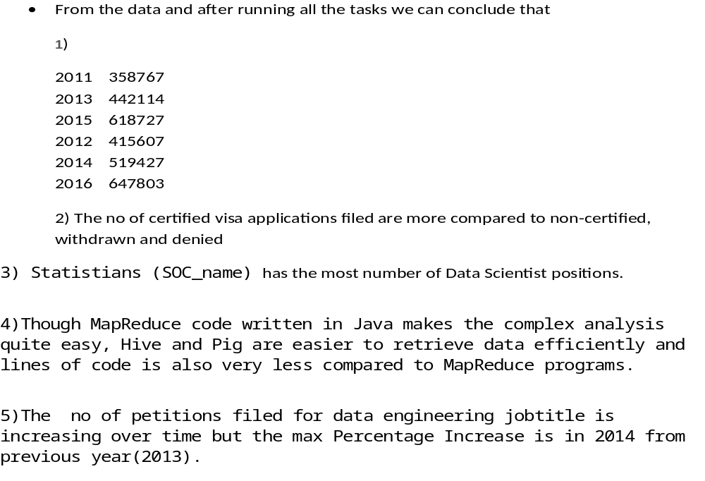
Conclusions

